Slide 1
Compiler Project Updates May 12
Arunabho Basu
Florida Institute of Cybersecurity Research Electrical and Computer Engineering Department

Slide 2


Overview
Objective : Secure Software Execution by implementing Physical Hardening during Compilation stage
Current objective : Proof-of-concept Example of Physical Hardening
Hardening against conditional branch instruction skipping
Fault Injection Analysis using SoFi to quantify the improvement made by Hardening
Harden
What happened during hardening ?
Faults modifying/bypassing branch condition will now directly lead to password checking failure instead of secret asset
Approach : Simple program wrote in C and compiled using C to RISCV cross compiler.
Compiled program co-simulated over PicoRV32 soft core.
The program counter is used to locate target instruction for Fault Injection and then SoFi is used for FIA.

Slide 3
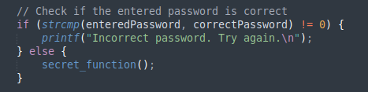
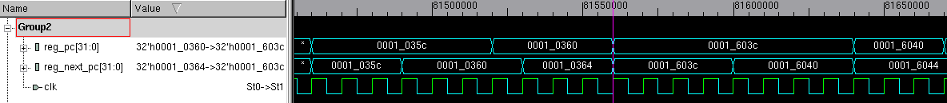
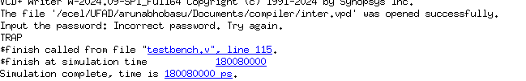
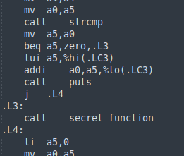

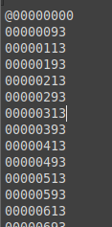
Fault Injection – Locating the Fault
Targeting the unsafe branch instruction for Fault Injection
Compile with C -> RISCV cross compiler
RTL simulation in VCS
password.elf
picorv32.v with firmware32.hex onboard memory
Add start.elf, and convert all to firmware32.hex

Slide 4

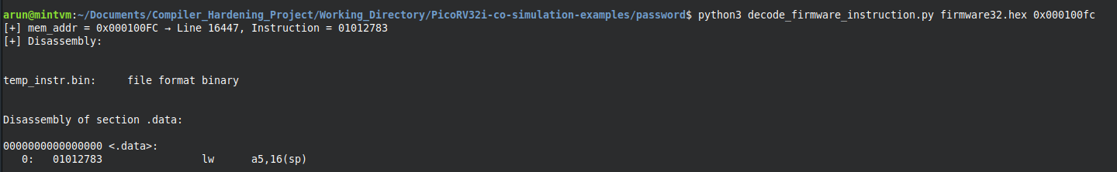
Fault Injection – Locating the Fault
Locate target register and cycle during simulation
reg_pc[31:0] – Program Counter
Dumped PC values – physical addresses
Looked up machine code in firmware at corresponding addresses
Disassembled and decoded machine code
Executed in recursive fashion to get all instructions disassembled
Automated using Python scripts

Slide 5
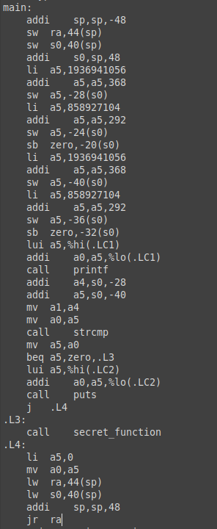
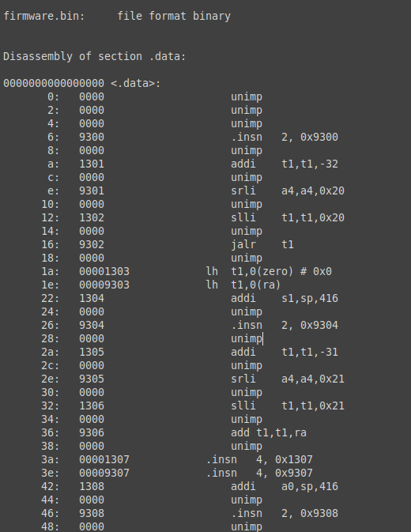
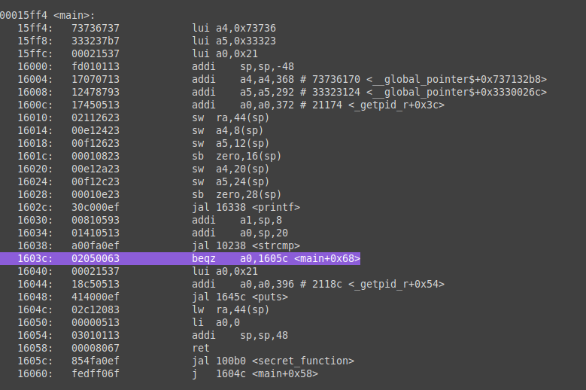
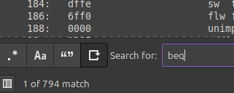
Fault Injection – Locating the Fault
Disassembled Firmware
Almost 800 branching instructions alone
Disassembled Firmware
Assembly Code before Linking
Fault Target : 0001603c: 02050063 beqz a0,1605c <main+0x68>

Slide 6
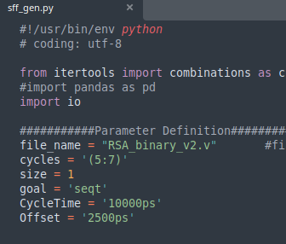
Fault Injection – Locating the Fault
Fault Target : 0001603c: 02050063 beqz a0,1605c <main+0x68>
Fault Target Cycle : 81560000 ps
Design Netlist + Fault Location +
Fault Cycle + Fault Type
sff_gen.py script to create Fault List for Z01X

Slide 7
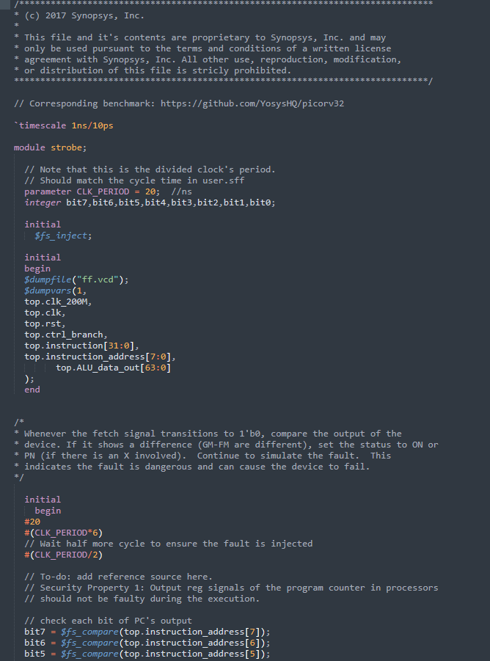
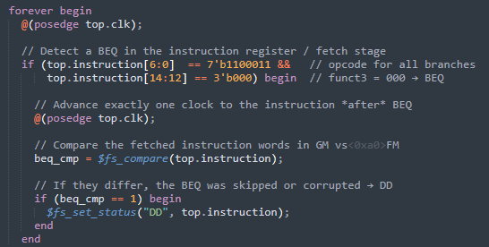
Security Properties
Implemented as Strove File
Security Property to detect skipping BEQ instruction
Fetch opcode at same location between Good Machine (GM) and Faulty Machine (FM)
If they differ, instruction was skipped or corrupted

Slide 8
Current Progress
Synthesize design to netlist file so it works with SoFi
Henian’s suggestion : use 32nm standard library and Cadence Genus for synthesis
Use sff_gen.py to create Fault List in a way it works with SoFi
Henian’s suggestion : split large fault list to segments so it doesn’t crash and take whole day
Make sure Fault List, Security Properties and Design are aligned in timing cycles
Run SoFi toolchain to do Fault Injection Analysis -> Quantify Impact of Hardening Technique

Slide 9
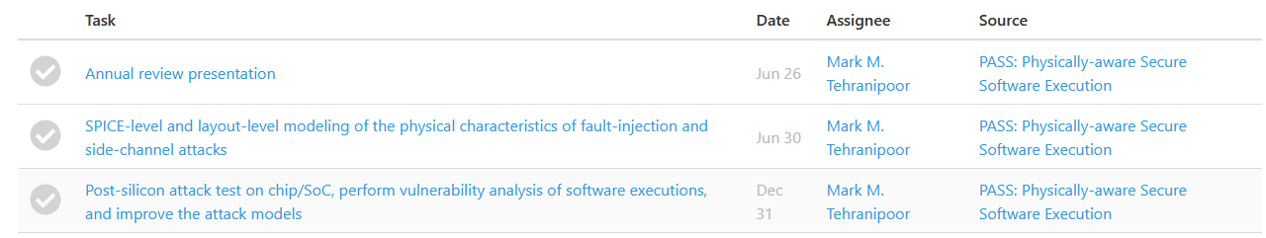
Upcoming SRC Deliverables
Summer Deliverables as per SRC Website
KPI Form
Deadline : June 26
On track to be completed by May 15 for advisor’s review
GRC Poster Presentation (June 3-4, UT Dallas)
Deadline : May 20
On track to be completed by May 15 for Dr Rakib’s and advisor’s review
Annual Review Presentation
Deadline : June 26
Early first draft completed and being reviewed by Dr Rakib, more content would be added over next few weeks

Slide 10
Upcoming SRC Deliverables
Summer Deliverables as per SRC Website
June 30 Deliverable
The timeline of project is presented intuitively in a step-by-step way but not aligned well with our development plan
There is a primary disconnect between proposed plan of tasks and actual plan which would affect our very first quarter deliverable

Slide 11
Project Tasks and Timeline
Proposed Timeline and Deliverables
Year 1 : Task 1
FIA Modeling
SCA Modeling
Attack Model Fine Tuning
Year 2 : Task 2
Compiler Development
Define Security Properties & develop Hardening Rules
Scaling Hardening Database
Year 3 : Task 3
Evaluation and debugging
Test and Demo on physical chips
Actual Development Plan
Year 1 : Task 1 and Task 2
FIA Modeling
Compiler Development
Attack Model Fine Tuning
Year 2 : Task 1 and Task 2
SCA Modeling
Compiler Development
Scaling Hardening Database
Year 3 : Task 3
Evaluation and Debugging
Test and Demo on physical chips

Slide 12
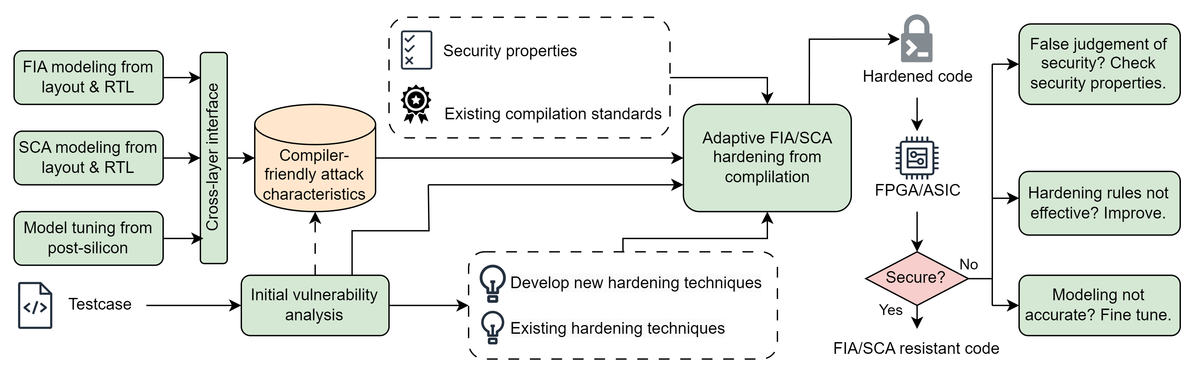
Proposed Project Tasks and Timeline
Task 1: Attack Modeling
Task 2: Compiler Development
Task 3: Evaluation
Which of the following should we do ?
Strictly follow the timeline, meaning that it's better we all put the major effort on SCA modeling now, and stop the compiler hardening effort since it's part of 2026 plan.
Doing it as the currently way, which is working on modeling, hardening in parallel. Then should we adjust the timeline to do SCA modeling at later years?

Slide 13
THANK YOU

Slide 14
Conditional Branch Hardening
Harden
What happened during hardening ?
Faults modifying/bypassing branch condition will now directly lead to password checking failure instead of secret asset
Hardening implemented by Static Branch Prediction Hint : __builtin_expect(branch condition, 0)
Security Property : Default fall-through branch handles error rather than security asset

Slide 15
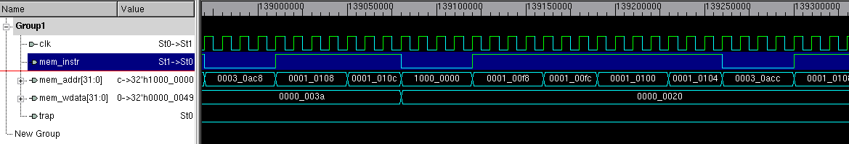
Next step – Evaluation of Hardening
Targeting the unsafe branch instruction for Fault Injection
Compile with C -> RISCV cross compiler
password.elf
RTL simulation in VCS
picorv32.v with firmware32.hex onboard memory
Add start.elf, and convert all to firmware32.hex

Slide 16
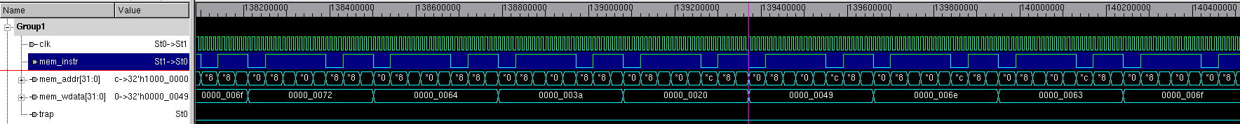
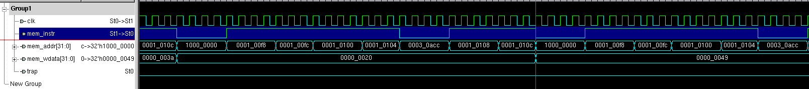
Analyzing the waveform to find target signal
o
r
d
:
_
I
n
c
o
Output buffer containing register goes from “Input Password: ” to “Incorrect Password”
Expanding to look at instructions in program counter around this time
Looking up the instruction at the particular memory location and disassembling it

Slide 17
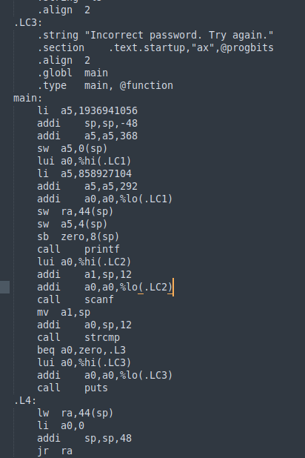
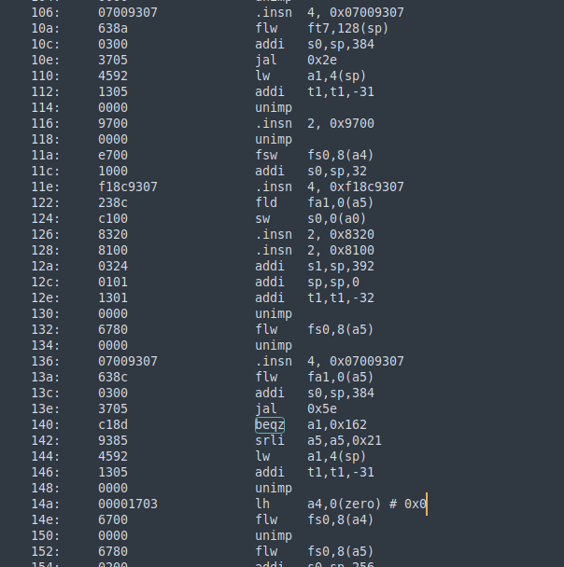
Current roadblock
Disassembled machine code don’t match high level unlinked assembly code
assemble + link
disassemble + unlink
High level assembly code before
Disassembled code from firmware

Slide 18
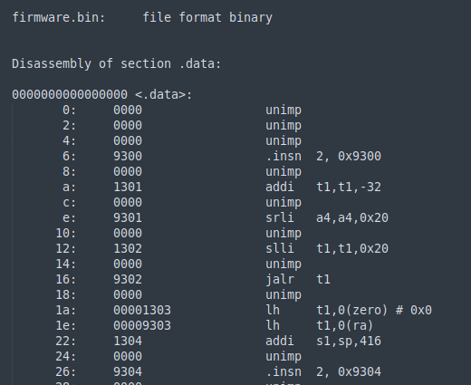
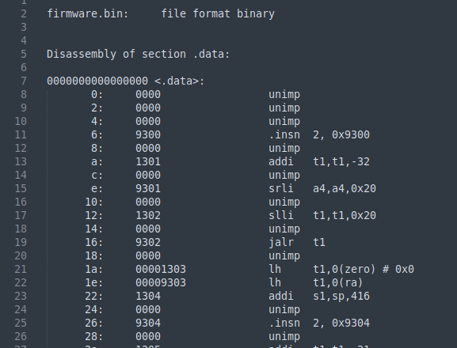
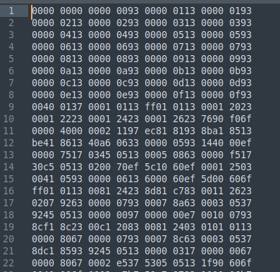
Current roadblock
Disassembled machine code don’t match high level unlinked assembly code
What’s possibly happening here :
Assembly to Machine is 1 to 1 but not the other way around ( example: MOV AX, BX and MOV AX, BX might compile to the same machine code as another mnemonic if the assembler allows aliases or if different syntaxes exist. )
Assembler optimizations and pseudo instructions ( example: NOP could be represented as MOV EAX, EAX or an actual 0x90 byte depending on context or architecture)
Different disassembler behavior based on target architecture, endian-ness
Assembler and Disassembler Pair Mismatch (Intel vs AT&T)
Unaligned Machine Code

Slide 19
Next steps
Evaluating the Hardening :
Mapping disassembled code to assembly code
Analyzing the waves to find targets that will impact critical instruction
Fault injection simulation using SoFi

Slide 20
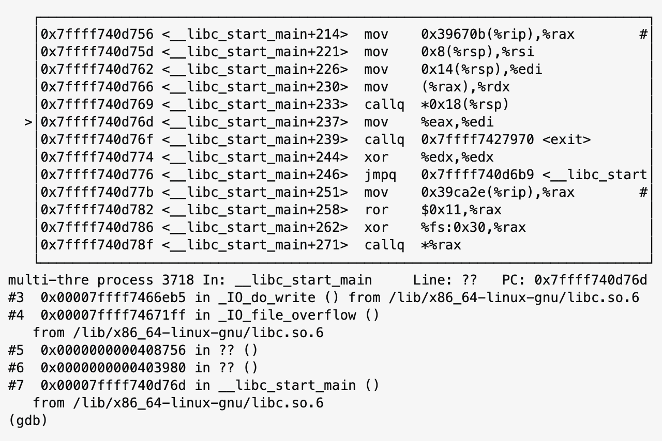
[Henian Slide] Locate Critical Assembly Code Snippets
Given several lines of critical C/C++, how do we determine
What part of assembly codes are generated from them?
When are these assembly instructions executed in hardware
What hardware resources these instructions are using? -> can be done by checking switching activities during a certain time window (still need to know the window first)
GDB built in riscv-gcc cross compiler does not come with this feature
The gcc-riscv cross compiler should be re-built with “—enable -tui” flag to support
Looking for the possibility to install this library
On the other hand, micro-architecture level fault simulators might have solved this issue
An example of using GDB debugger to locate specific assembly instructions

Slide 21
Progress at a glance
Making decent progress, on track to meet first quarter deliverables
Deliverables : 1) SRC first quarter report by April **
**Need access to SRC project on pillar science website
Detailed analysis of GCC compiler introduced vulnerability and its corresponding hardening
How Branch Prediction Optimization makes code more vulnerable to LFI
Shared reading materials with Mashahed and bringing him upto speed on the project
Making the toolflow setup accessible to Pantha and Mashahed so we can work together

Slide 22
Conditional Branch Hardening
Harden
What happened during hardening ?
Faults modifying/bypassing branch condition will now directly lead to password checking failure instead of secret asset
Hardening implemented by Static Branch Prediction Hint : __builtin_expect(branch condition, 0)
Security Property : Default fall-through branch handles error rather than security asset

Slide 23
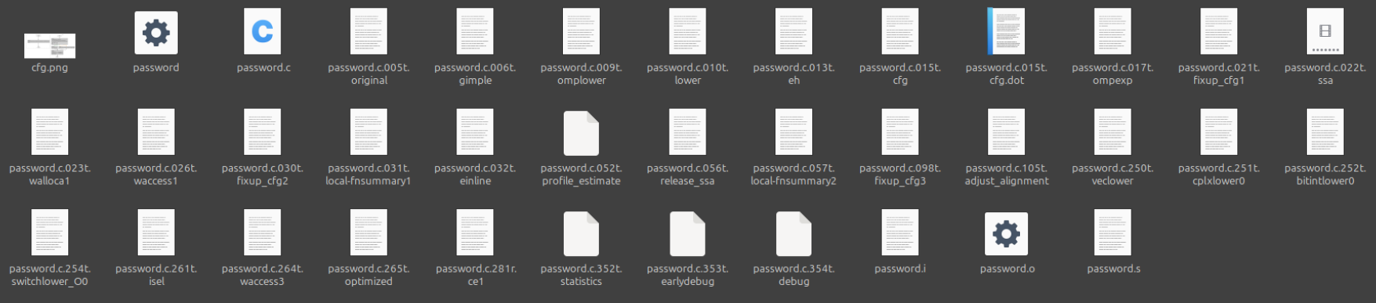
Dumped all internal states of compilation and studied how compilation takes place.
$ riscv32-unknown-elf-gcc -fdump-tree-original password.c –c
$ riscv32-unknown-elf-gcc -fdump-tree-gimple password.c –c
$ riscv32-unknown-elf-gcc -fdump-tree-all password.c –c
$ riscv32-unknown-elf-gcc -O2 -fdump-tree-cfg-graph -c password.c

Slide 24


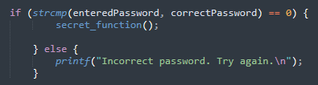
Before and After Branch Prediction Optimization
$ riscv32-unknown-elf-gcc -O2 -save-temps password.c -o password
$ riscv32-unknown-elf-gcc -O1 -save-temps password.c -o password
After
Before
Branch Prediction Optimization switched the default branch
High level code had error in default branch (else)

Slide 25
Branch Prediction Optimization
Branch Prediction Optimization
Hot Branch
Most likely taken branch based on analysis
Cold Branch
Less likely taken branch based on analysis
How does this optimization help?
Optimization : Hot Branch Instructions clustered together and pre-loaded into instruction cache pipeline so they can be readily fetched if condition is met
If branch condition is met next instruction is already in pipeline (saves time)
If branch condition is not met pipeline is flushed and cold branch is loaded (takes more time)

Slide 26
Branch Prediction Optimization
Branch Condition
Hot Branch
Instruction Cache Pipeline
Cold Branch
How does this optimization help?
Optimization : Hot Branch Instructions clustered together and pre-loaded into instruction cache pipeline so they can be readily fetched if condition is met
If branch condition is met next instruction is already in pipeline (saves time)
If branch condition is not met pipeline is flushed and cold branch is loaded (takes more time)

Slide 27
Branch Prediction Optimization - Vulnerability
Branch Condition
Access to Secret Asset (Hot Branch)
Instruction Cache Pipeline
Error Handling (Cold Branch)
How does this introduce Fault Injection Vulnerability ?
- Faults modifying/bypassing branch condition will now directly lead to secret asset

Slide 28
Branch Prediction Optimization - Vulnerability
Vulnerability :
Branch Predictor does not know if a branch has security asset and should be kept cold
Branch Predictor decides hot (most likely) or cold (less likely) based on heuristic analysis
Heuristic Analysis – detect error handling code, assign it cold always
Standard GCC compiler in default setting would always assign error handling branch as cold even if other branch has security asset

Slide 29
Branch Prediction Optimization - Hardening
Hardening :
Simple naïve solution : Turn off Branch Prediction Optimization
Advanced solution : If there is a security asset, assign it always cold
Static Branch Prediction Hint : __builtin_expect(branch condition, 0)
Profile guided Optimization (Dynamic) : Branch Prediction is guided by a profile containing branch weights (customizable)
Security Property Hardened : Default fall-through branch handles error rather than security asset

Slide 30
Next step – Evaluation of Hardening
Evaluating the Hardening :
Impact on performance – time taken and resources used measured before and after hardening
Impact on Fault Injection Resilience – measured using SoFI before and after hardening

Slide 31
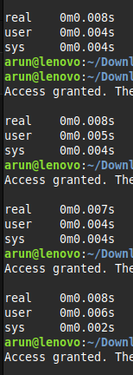
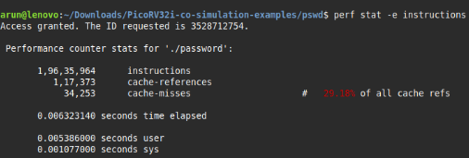
Next step – Evaluating Performance
Evaluating the Hardening :
Impact on performance – time taken and resources used measured before and after hardening
Time measured showed negligible overhead
Possible reasons : short and lightweight program, maybe parallel processing was involved(?)
Performance measured using perf : slightly increased cache-miss because now security asset needs to be loaded from cold branch
Next step : evaluate other heavier programs
Impact on Fault Injection Resilience – measured using SoFI before and after hardening
Working with Pantha to troubleshoot SoFI

Slide 32









Next steps – Evaluating Fault Resiliency
Co-simulation using suitable Verilog simulator
PicoRISC-V CPU
Verilog softcore
RV32i ISA
Test program (for FIA)
Runs on RISCV (written in C, compiled using riscv cross compiler)
Compiled code converted to 32bit firmware in hex format
PicoRV32 CPU with test program loaded into memory
Analyze the waveforms to identify LFI target signals
SoFI Framework
Quantified hardening analysis and report
LFI Target list used to generate : - security properties and - hardening rules
Input – Design File, Security Properties File, Fault List
Output – Fault Assessment

Slide 33
The issues with SoFI
INPUT 2 : Critical Locations/Fault list
Identifying critical locations from waveform analysis – local fault targeting our security property or global faults?
INPUT 3 : Security Properties File
Defining security property in a way SoFI can understand. Henian suggested editing his file but I am not sure if its working
INPUT 1 : Design File
Henian’s work show gate level netlist of design is accepted. Our RTL level design was synthesized to Gate level netlist.
SoFI Framework
Quantified fault resiliency report
The synthesis process directly impacts the physical modelling of faults

Slide 34
Current Framework
Firmware loaded on to memory of CPU core
PicoRISC-V CPU
Verilog softcore
RV32i ISA
Test program (for FIA)
Runs on RISCV (written in C, compiled using riscv cross compiler)
Compiled code converted to 32bit firmware in hex format
PicoRV32 CPU with test program loaded into memory

Slide 35
Current Framework
Co-simulation using suitable Verilog simulator
PicoRV32 CPU with test program loaded into memory
Analyze the waveforms to identify LFI target signals
SoFI Framework
Quantified hardening analysis and report
LFI Target list used to generate : - security properties and - hardening rules
Input – Design File, Security Properties File, Fault List
Output – Fault Assessment

Slide 36
Current Roadblock
Co-simulation using suitable Verilog simulator
PicoRV32 CPU with test program loaded into memory
Analyze the waveforms to identify LFI target signals

Slide 37

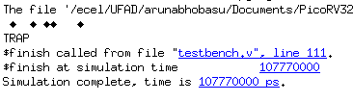
Current Roadblock
Co-simulation using suitable Verilog simulator
PicoRV32 CPU with test program loaded into memory
Analyze the waveforms to identify LFI target signals
Example (using Hello World):
vs
Simulation using Iverilog
Simulation using VCS

Slide 38
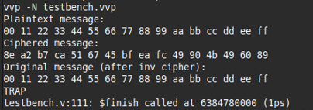
Troubleshooting update
What we know :
VCS not cosimulating it correctly
Not an issue with machine – same error reproduced on Henian’s machine
Not an issue with test program code, all programs cosimulated on VCS giving erranous results while its working on iverilog
What we’re trying :
- Troubleshooting using error codes
- Checking VCS options from man page
- Modifying testbench
- Check other simulators
Another Example (using AES):
Simulation using Iverilog
Simulation using VCS

Slide 39
Current Progress
Reading up on SoFI tool and how to use it
Researching FIA Vulnerability Analysis :
Features/Characteristics that help in quantifying hardening
Features that help in improving physical attack model
Features whose impact can be augmented by compiler level hardening
Reading up on LFI and Physical Modeling

Slide 40
Next Steps
Identifying Critical Instructions/Locations
Developing a framework that can identify critical instructions in code
Identifying hardening technique – replacement/addition/rewriting
which gives positive change in hardening metrics,
while keeping overhead low, and
implementable during compilation stage

Slide 41
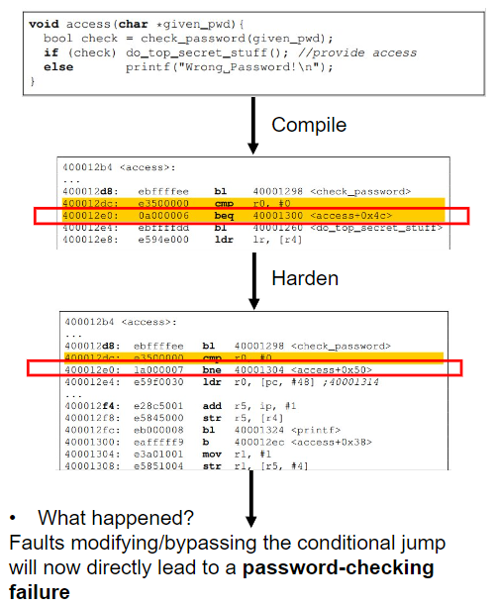
Hardening example
Develop a GCC plugin that takes the non-hardened version and hardens it
Very similar approach to linting software
Required : Clear understanding of pre-processing stage and compilation stage of gcc-riscv32 compiler – how source code is translated to riscv instruction
Other hardening rules?

Slide 42
Objective 1 – Compiler Toolchain
Architecture in use : RISC-V
Core in use : PicoRV32
GCC Cross-Compiler toolchain : gcc-riscv32-unknown-elf
Current Tasks :
Getting familiar with RISC-V ISA and the GCC cross compiler toolchain
Have started compiling simple programs to better understand pre-processing and compiling stage
Goal is :
Compile an AES program with a LFI vulnerable instruction
Develop a plugin that hardens the said instruction

Slide 43
Physical Fault Modelling
Existing GCC Options
Compile time Options
Run time Options
Control Flow Options
Stack Hardening
Function hardening
Jump statement hardening
Loop Hardening
Pointer Hardening
FI/SCA model vectors
FI
Laser
Clock
Voltage
SCA
EM Wave
Power
Time
Attacks which can be detected/prevented by these options

Slide 44
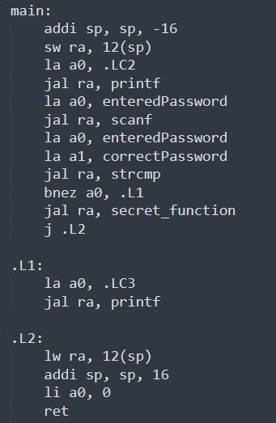
Challenges in security Hardening
Hardening Toolflow :
Identify and locate critical instructions, vulnerable to fault injection
Harden the critical instruction
Going from C code to RV32i assembly code, locating critical instruction is not very straightforward
Pre-silicon vs Post-silicon
RTL simulation cycle varies from actual hardware implementation cycle – making finding exact cycle even harder

Slide 45
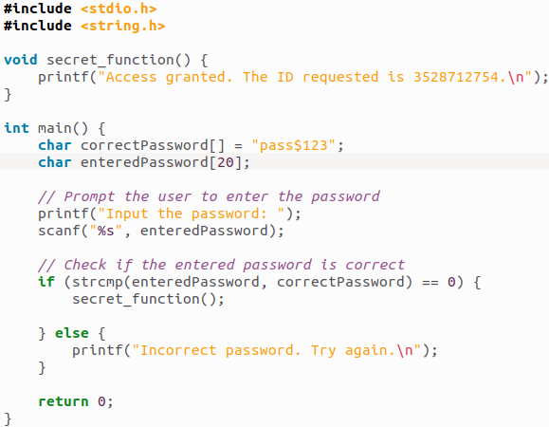
Security Hardening Example
Henian’s example of a simpler testcase: password authentication
Call secret function under the correct key input
What if “bnez a0, .L1” is skipped?
compile

Slide 46
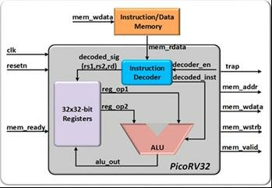
PicoRV32 Core
PicoRV32 is a Verilog softcore
Simulated on local machine and the compiled code is co-simulated on top of the softcore by inserting it into the memory of PicoRV32

Slide 47
RISC-V compilation
GCC Cross Compiler
C Code
Compiled RV32i code
Pre-processing
Replaces macros and includes header files, resulting in a pure C source file with no preprocessor directives.
riscv32-unknown-elf-gcc -E fics.c -o fics.i
Compilation
Translates the preprocessed C code into assembly code for the RISC-V architecture
riscv32-unknown-elf-gcc -S fics.i -o fics.s
Assembly
Converts the assembly code into machine code, resulting in an object file
riscv32-unknown-elf-as fics.s -o fics.o
Linking
combines one or more object files (and any required libraries) into a final executable file
riscv32-unknown-elf-gcc fics.o -o fics

Slide 48
Compiler Project Updates Feb 3rd
Arunabho Basu
Florida Institute of Cybersecurity Research Electrical and Computer Engineering Department

Slide 49
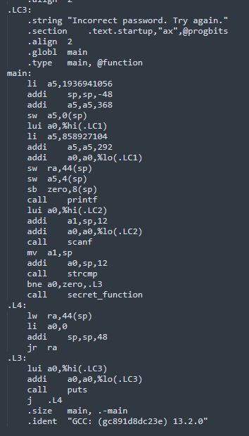
Security Hardening Example
Example of a simple testcase: password authentication
Call secret function under the correct key input
What if “bne a0, zero, .L3” is skipped?
compile
PC falls through to next sequential address which is the secret

Slide 50
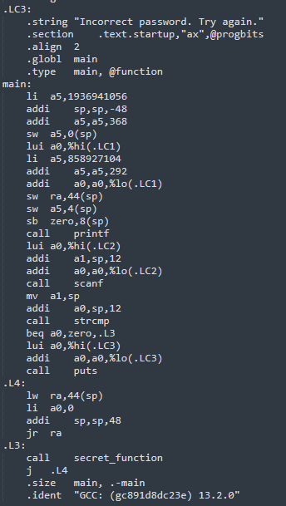
Security Hardening Example
What if “beq a0, zero, .L3” is skipped?
harden
PC can never reach branch L3 containing Secret Function

Slide 51
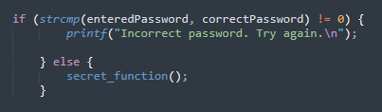
High Level Analogy
Same operation implemented in two ways :
Inequality Check
Equality Check
High level logic:
If passwords don’t match
Jump to Error
Default (else) : Access Secret
High level logic:
If passwords match
Jump to Access Secret
Default (else) : Error

Slide 52
Attacker’s Perspective
Attacker’s Goal : Skip bne instruction
Result : PC falls through to secret branch
Attacker’s Goal : Make beq instruction always true
Result : PC jumps to secret branch

Slide 53
Primary LFI Target
a0
a0
Comparator Is a0 != 0 ?
OR
Comparator Is a0 == 0 ?
OR
Branch Target Address
Branch Target Address
Error
Final PC
Secret
MUX PC Decision
Final PC
MUX PC Decision
Next Sequential Address
Next Sequential Address
Secret
Error
Branch Condition
Branch Condition

Slide 54
Other LFI Targets – Harder to Exploit
Register File: If the attacker can flip the value in a0 from nonzero to zero, then the branch condition changes. (Harder to flip because of small time window)
Instruction Decoder: A fault might corrupt the bne instruction opcode itself, turning it into a no-op or an always-jump. (Multiple Faults + Very hard to flip to target opcode)
Pipeline Latches/Flip-Flops: The pipeline stage registers store intermediate signals—if you flip the stored comparator result or the branch target PC, you can misdirect control flow. (Multiple Faults + Very hard to flip to target address)
PC Increment Logic: Even if the comparator is correct, messing with the final PC increment or branch addition could skip or misalign instructions. (Multiple Fault + Hard to locate)

Slide 55

Quantifying Hardening
SoFI
FIA Vulnerability Analysis (1)
Non-Hardened Assembly Code
SoFI
FIA Vulnerability Analysis (2)
Hardened Assembly Code
Hardening Metric = 2-1

Slide 56
SoFi Fault Analysis – Current Progress and Challenges
Current Progress – Troubleshooting SoFI RTL Implementation
SoFI Input :
RTL Design File –
Co-simulation of softcore RISC-V and non hardened program executable
Generates VCD file of simulation from VCS
Challenge – Timing and memory mapping the co-simulation
Stimulus VCD File –
ZO1X simulation to find faults that violate SP
Security Property File (Strobe File) –
No instruction skipping
Challenge – Locating the fault cycle

Slide 57
SRC Proposal Deliverables and Timeline
Year 1
Quarter 1-3 : SPICE-level and layout-level modeling of the physical characteristics of fault injection and side-channel attacks
Quarter 4 : Post-silicon attack test on chip/SoC, perform vulnerability analysis of software executions, and improve the attack models.
Quarter 1 : Investigation and development of physically-aware hardening techniques
Quarter 2 : Developing executable security properties and LUT/ML-based model interfaces to guide hardening strategies.
Quarter 3-4 : Integration of hardening techniques into software compilation in the form of GCC plug-in/LLVM/Clang
Quarter 1-2 : Extensive validation of the PASS flow on FPGA platform with iterative test of hardened software compilations
Quarter 3-4 : Broadening the attack scenarios by including more security properties, and fine-tuning of physical attack models.
Year 2
Year 3

Slide 58
SRC Proposal Deliverables – Year 1 (2025)
Qtr 1
Qtr 2
Qtr 3
Qtr 4
FIA Modeling : SPICE Level
FIA Modeling : Layout Level
SCA Modeling : SPICE Level
SCA Modeling : Layout Level
Post Silicon Attack Test
Vulnerability Analysis of Software Execution
Improve Attack Models

Slide 59
SRC Proposal Deliverables – Quarter 1 (March 2025)
Qtr 1
Fault Injection Modeling – SPICE Level
Set up RTL design files
Set up Testbench
Run Transient simulations
Model and inject fault during transient simulations
Harden and repeat last step
Evaluate difference between before and after

Slide 60
THANK YOU

